Slide 1
Technology college students and mental health
Kate Messitte & Tori Duckworth
Notes:
We are analyzing how academic workload and perceived course difficulty relate to the mental and physical well-being of college students in tech majors. Our goal is to understand whether higher workload and stress are associated with increased anxiety, depression, and burnout. For this presentation we decided to report on most of our findings from our data analysis

Slide 2
Does academic pressure play a role in students Mental Health?
Or are there other factors that influence technology students?
Notes:
Tori

Slide 3
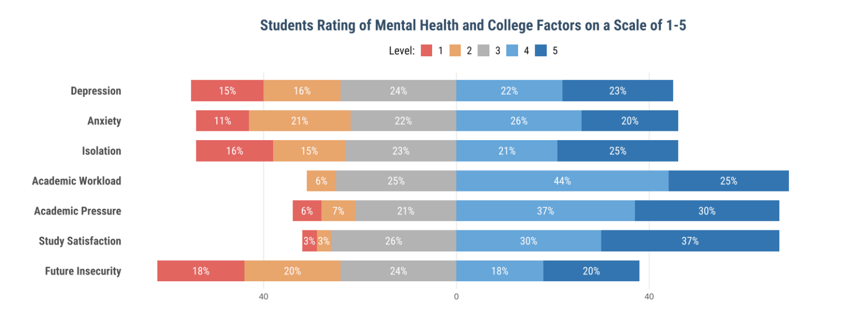
What percent students fall into each category?
Notes:
Tori

Slide 4
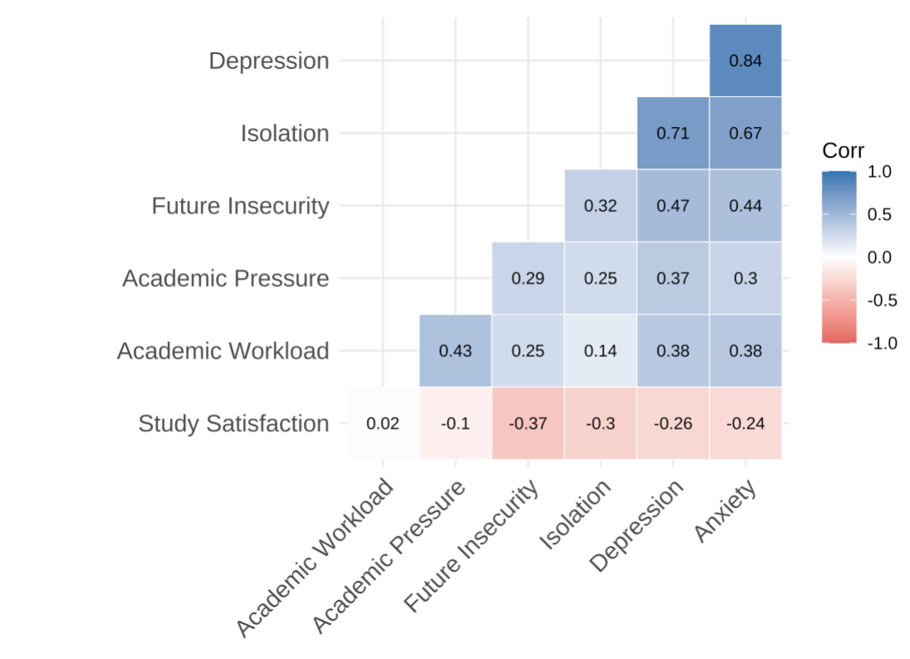
Correlation of Variables
Notes:
kate

Slide 5
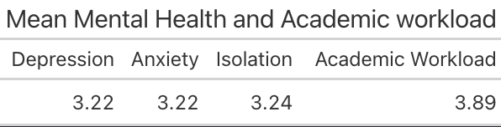
What does Students Mental Health look like overall?
Notes:
kate

Slide 6
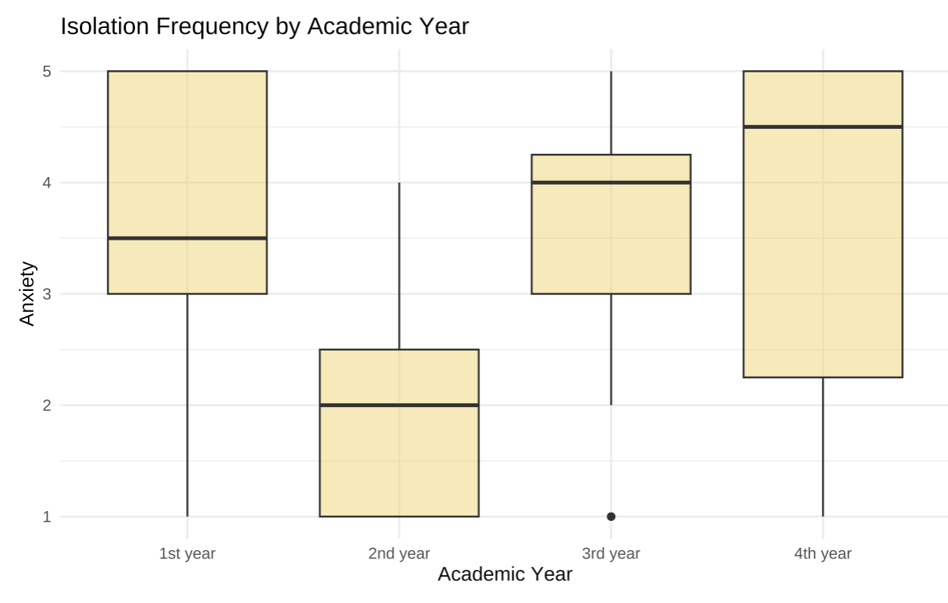
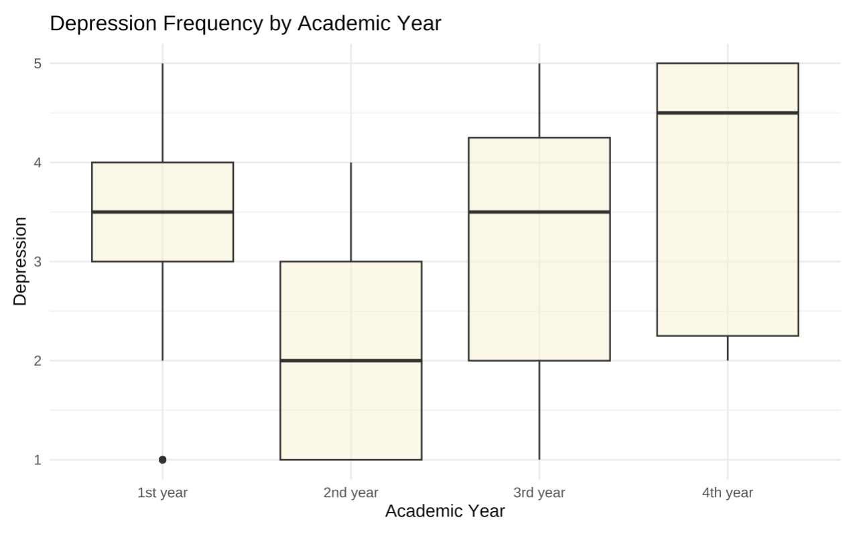
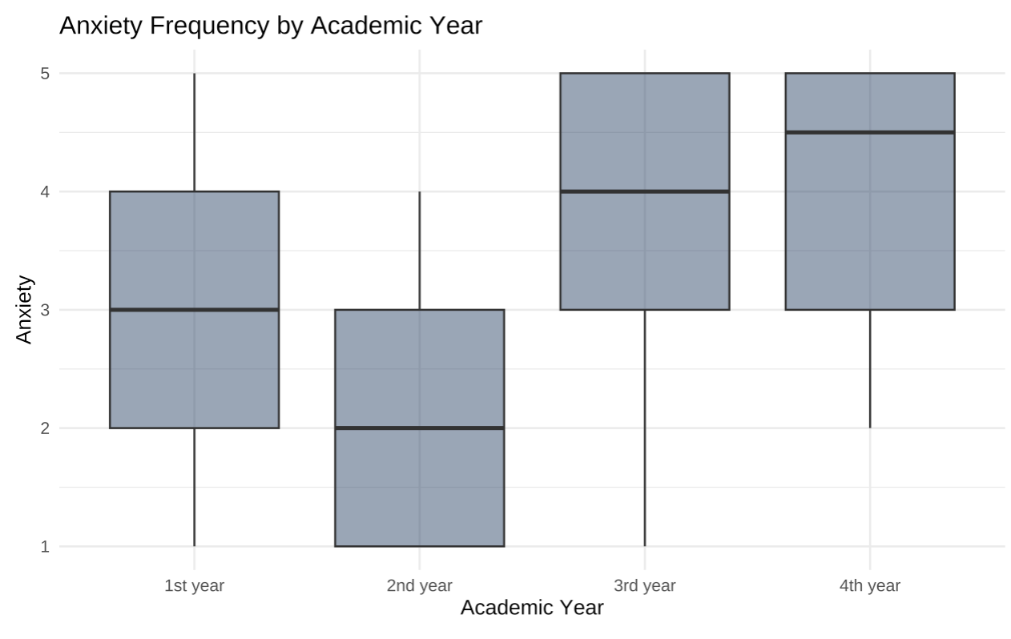
Academic Year & Mental Health
Notes:
Tori

Slide 7
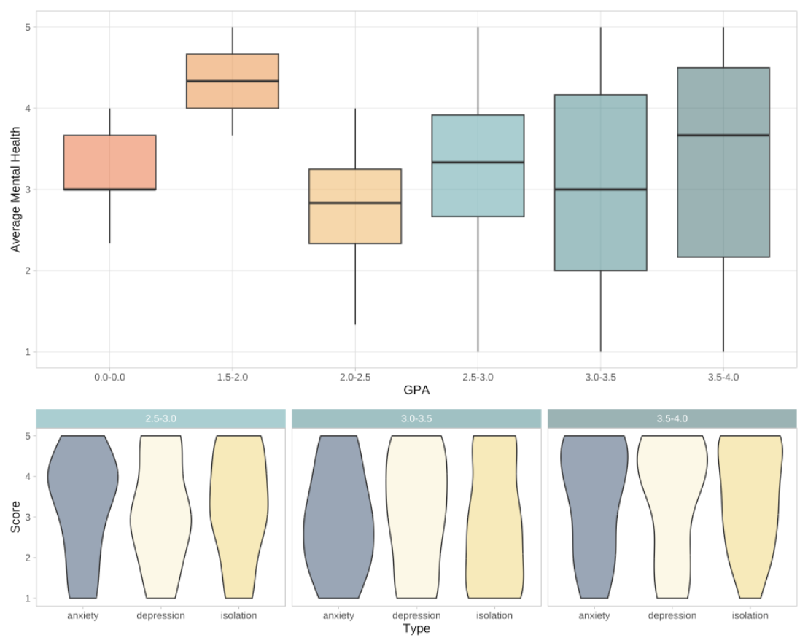
GPA & Mental Health
Notes:
Tori

Slide 8
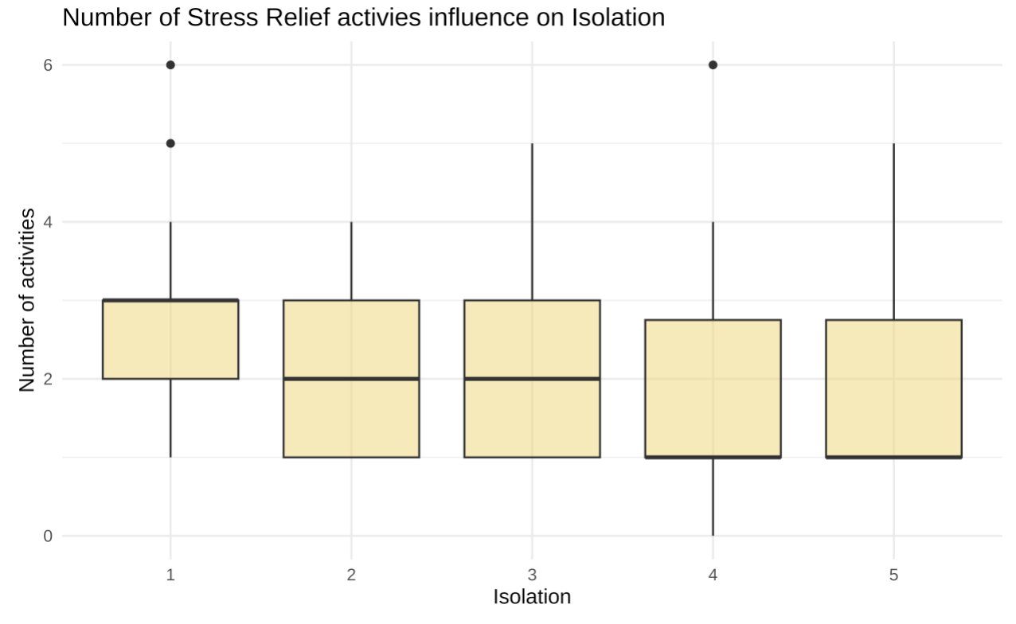
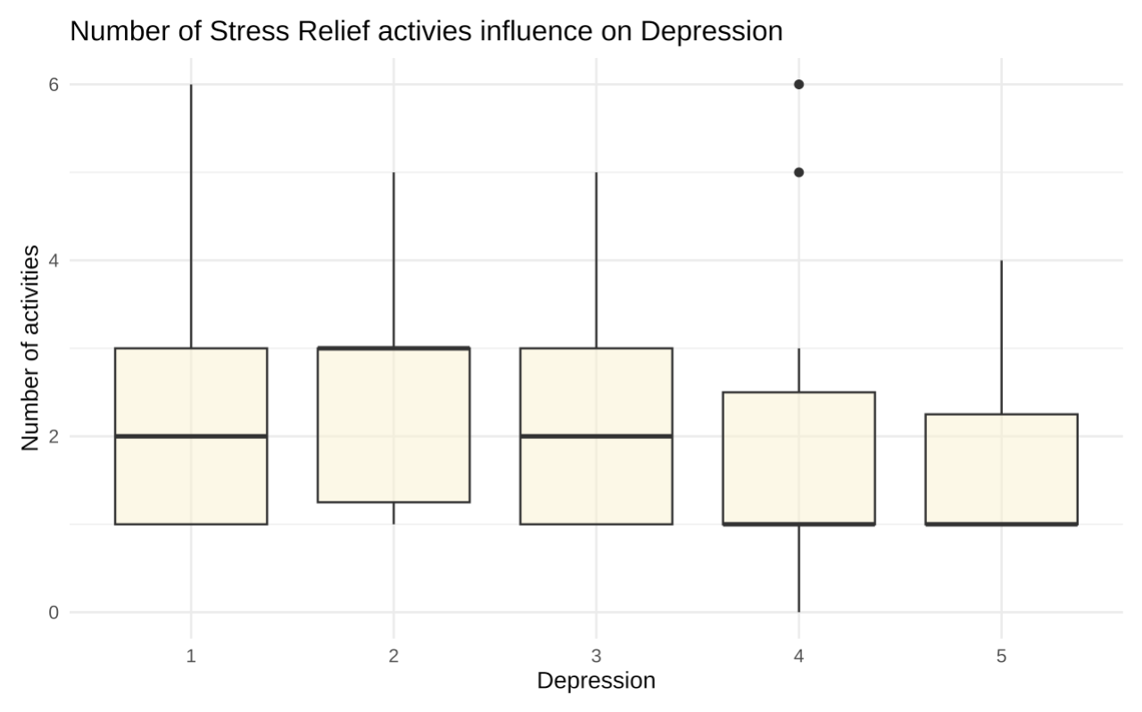
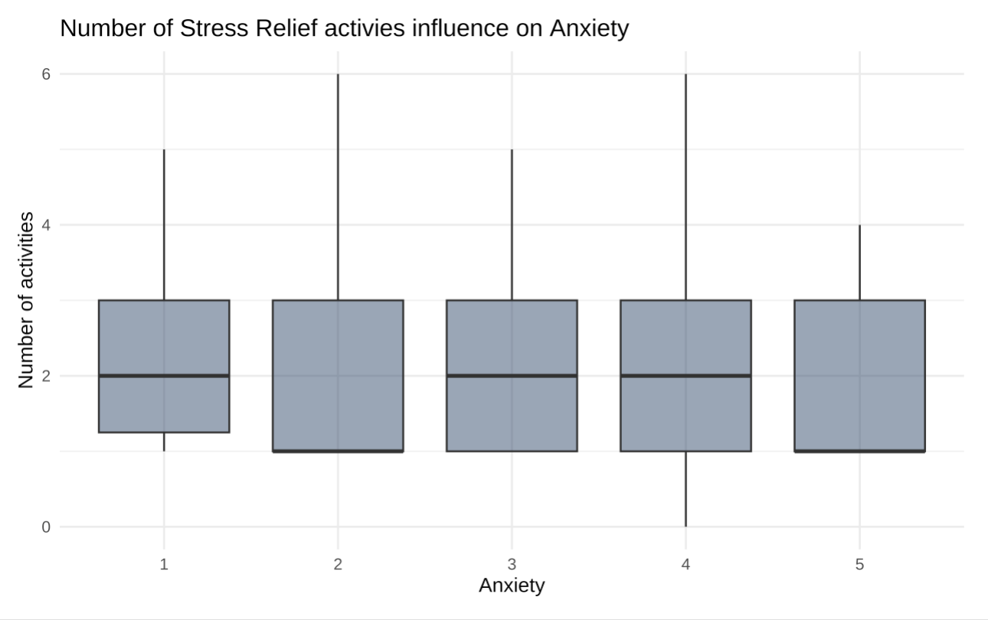
Number of Hobbies & Mental Health
Notes:
Tori

Slide 9
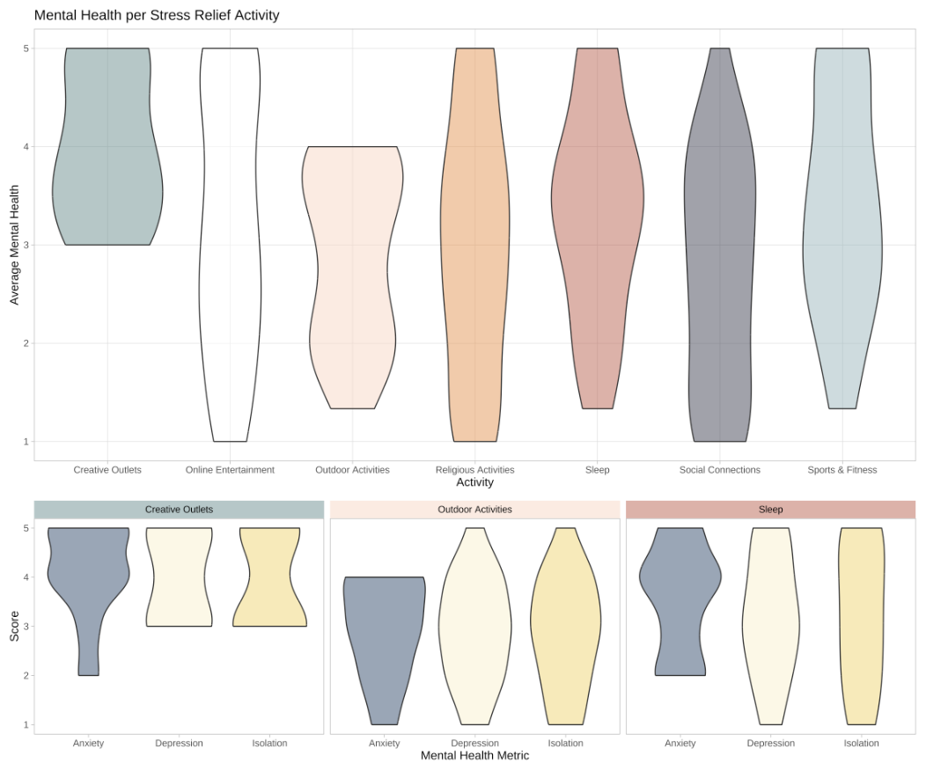
Stress Relief Activities & Mental Health
Notes:
Tori

Slide 10
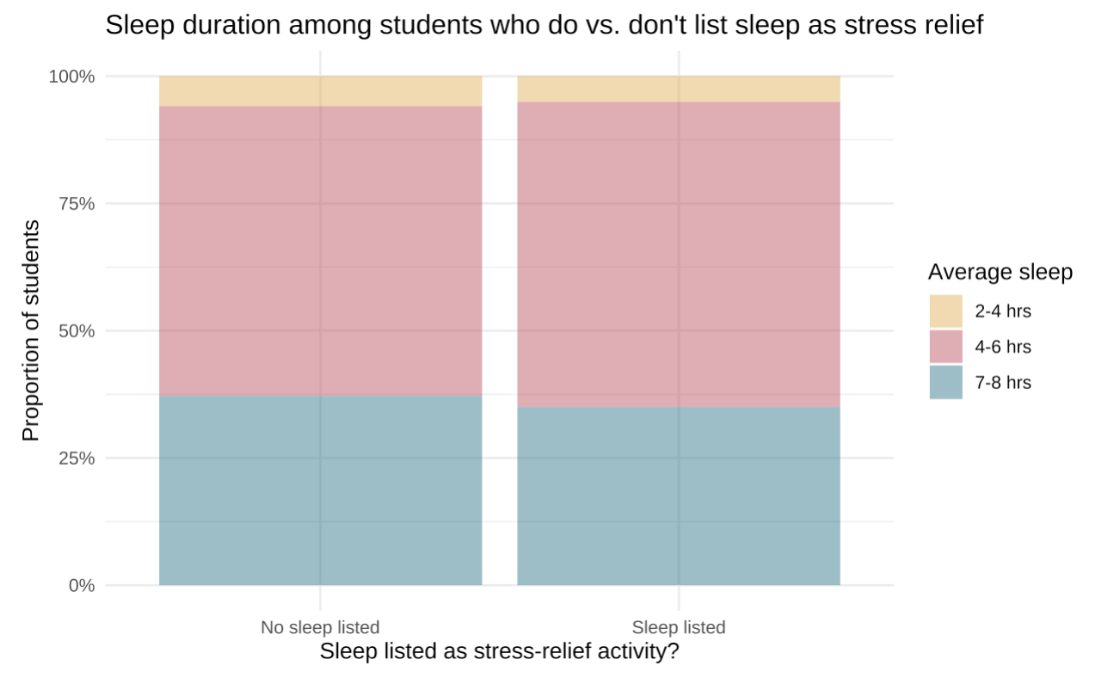
Sleep as a stress relief activity
Notes:
kate

Slide 11
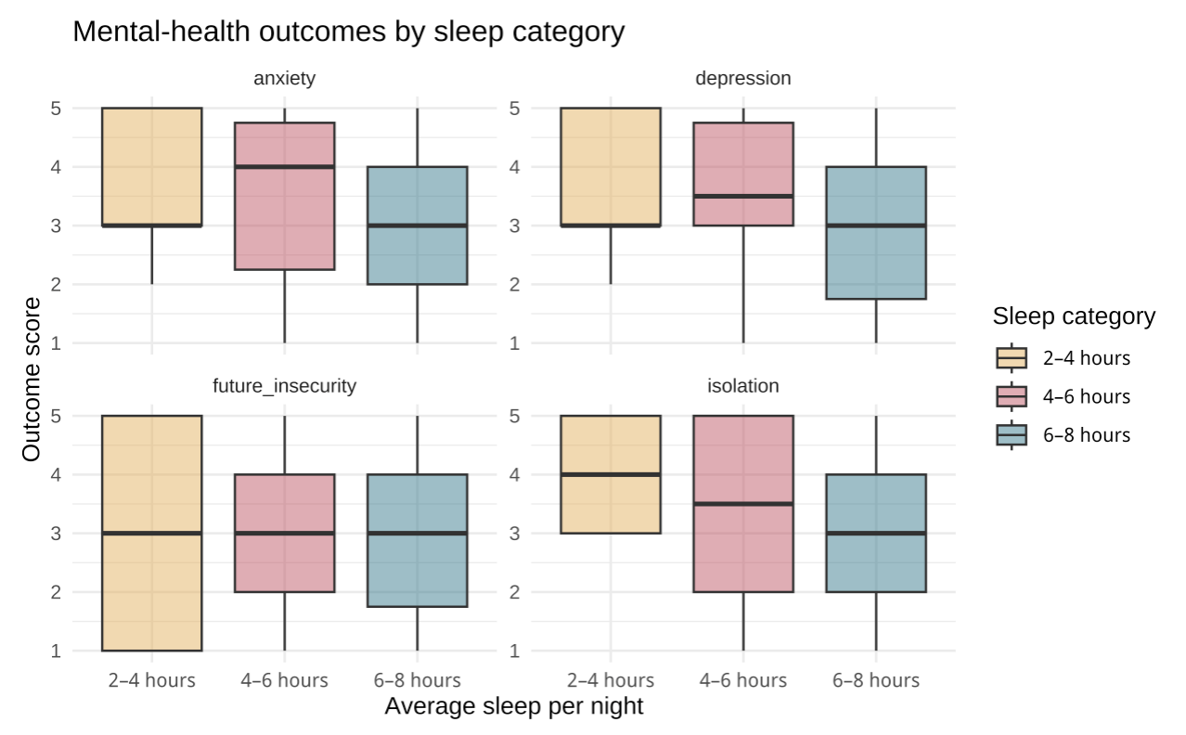
Sleep and mental health outcomes
Notes:
kate

Slide 12
Conclusion
Mental health is influenced by many interconnected factors, academic workload, personal circumstances, and individual dispositions all play a role.
No single variable fully explains students’ mental-health outcomes; patterns emerge from how multiple pressures interact.
Academic difficulty still matters and should not be dismissed as a contributing factor.
Supporting students holistically — academically and personally — is essential for well-being.
Notes:
kate

Slide 13
For more information go to the following website
https://mac-stat212-f25.github.io/project-model_citizens/

